Slide 1
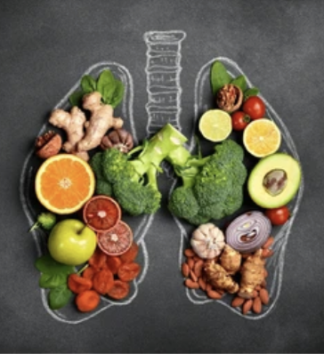
Reviving an Old Ally:
Nutrition: The Forgotten Frontline in TB Prevention
‘Good ideas are not necessarily new ideas but old ideas resurrected at the proper time”- Charles Handy in The Hungry Spirit.
Dr Nkirote Mugambi-Nyaboga
Chief of Party: Tamatisha TB
Centre for Health Solutions - Kenya

Slide 2

Outline
Global & regional burden of TB
01
04
Nutrition in TB management
07
Programmatic issues
02
TB–malnutrition comorbidity
05
Nutrition as prevention
08
Kenya/SSA context
03
Malnutrition as a risk factor
06
09
Mechanisms
Conclusions

Slide 3
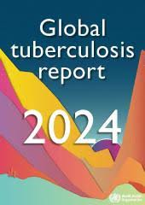





Global TB Burden
TB
10.8 Million
1.25 Million
The world’s leading cause of death from a single infectious agent
New TB cases
TB deaths (including 161,000 PLHIV)
SSA Accounts
END TB Targets
SSA accounts for large share of TB burden (HIV, poverty, undernutrition)
End TB targets require multi-faceted interventions
TB: The world’s leading cause of death from a single infectious agent
2023: 10.8 million new TB cases
1.25 million TB deaths (including 161,000 PLHIV)
SSA accounts for large share of TB burden (HIV, poverty, undernutrition)
End TB targets require multi-faceted interventions

Slide 4
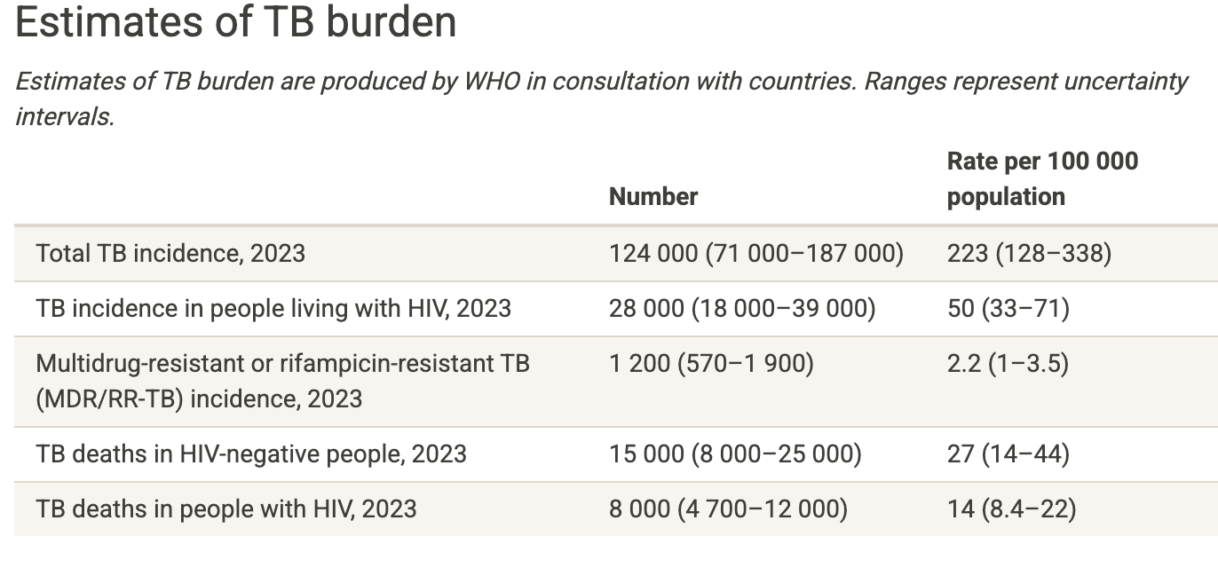
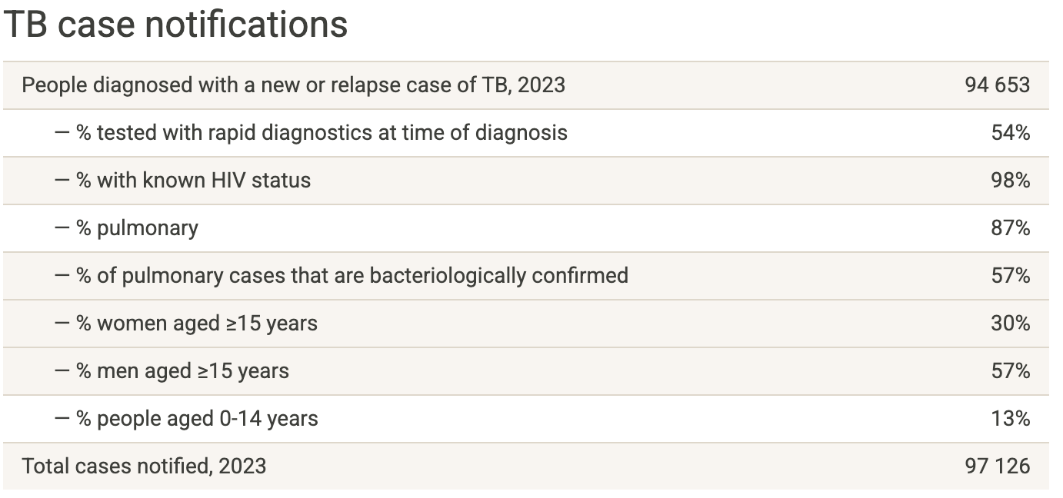
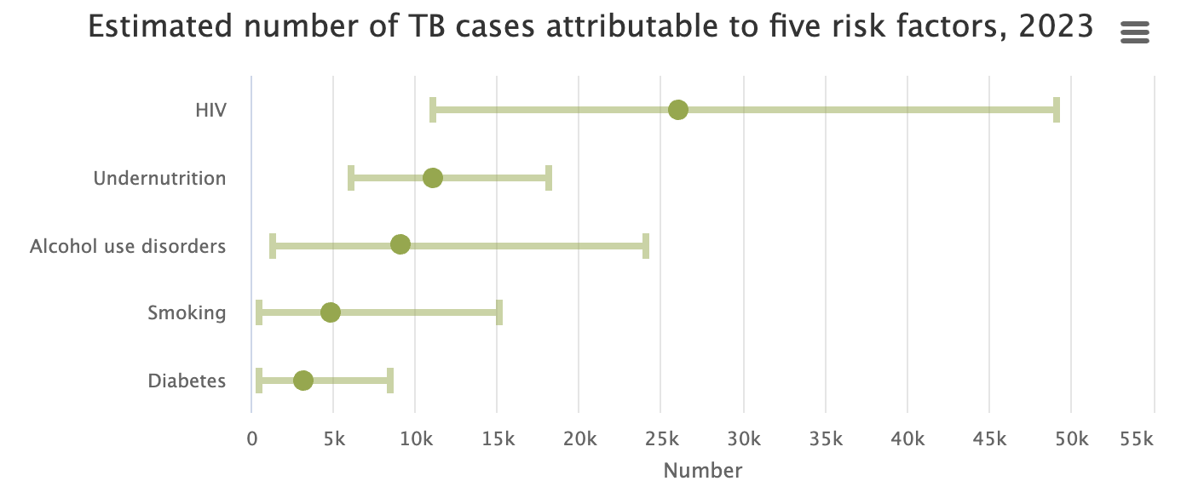
TB in Kenya Data 2023
Kenya
Great strides in incidence
and mortality End TB targets
Still missing 24% of estimated incident cases

Slide 5
Why Malnutrition Matters; Malnutrition as a risk Factor for TB
1
2
3
4
5
Historical “natural experiments”: improvements in nutrition preceded declines in TB incidence in early 20th century Europe; prisoners-of-war who received additional rations had far lower TB rates than those who did not
‘”Food as vaccine”
Undernutrition is not just a comorbidity: it is a strong risk factor for developing active TB globally
WHO, 2024
An estimated ~1.9 million TB cases globally are attributable to undernutrition (i.e., population attributable fraction)
Wagnew et al., 2023
Low BMI (< 18.5 kg/m²) associated with 2–3× increased risk of progression from latent to active TB
Cintron et al., 2021
Common risk factor for mortality

Slide 6
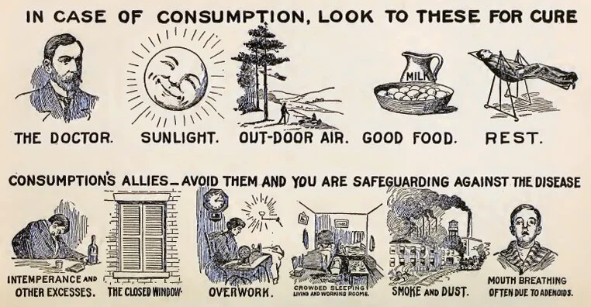
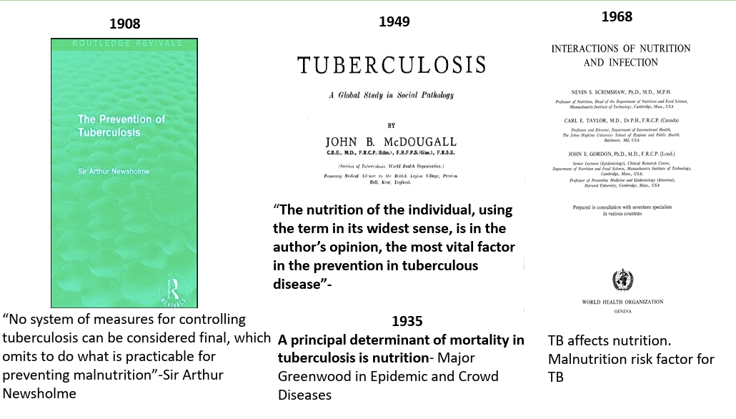
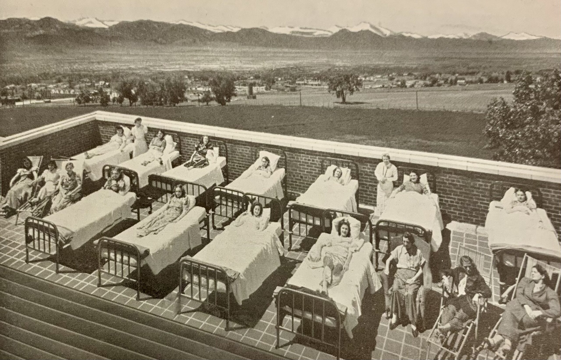
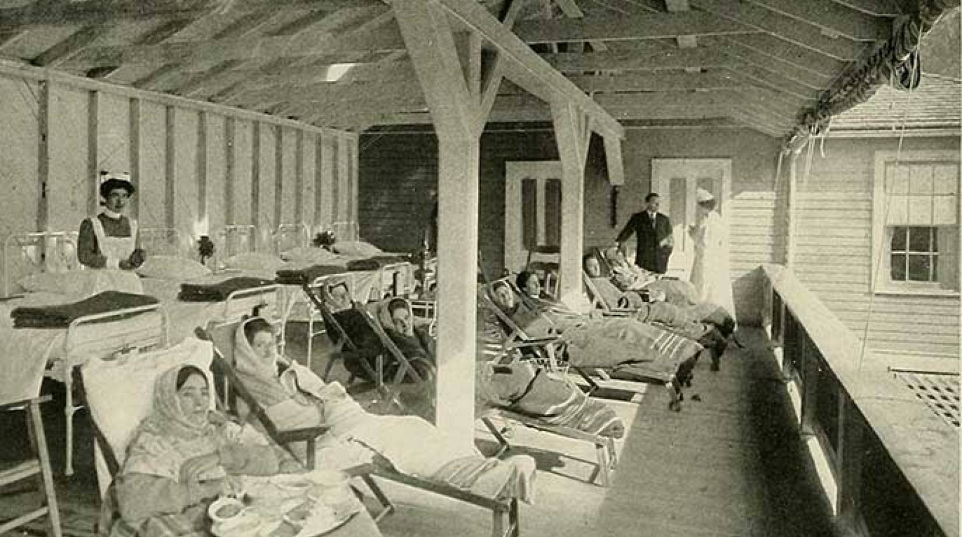
Food: The TB vaccine we already have

Slide 7
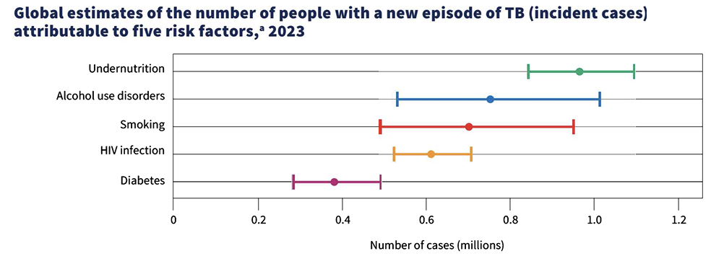
TB and Malnutrition
Undernutrition; Leading risk factor for TB globally
1
2
Common risk factor for mortality
Many TB patients present with undernutrition (30-50%)
A meta-analysis in Ethiopia: pooled prevalence of undernutrition among TB patients ~48.2 % (95% CI) (Feyisa et al., 2024)
Burkina Faso: 35.8 % of TB patients had BMI < 18.5 kg/m² (Musuenge et al., 2020)
Kenya undernutrition: up to 48% (Annual TB reports)
Some counties e.g Turkana high prevalence of undernutrition among TB patients (60%) (Nthiga et al., 2017)
3
4
Malnutrition often persists even after treatment
Often associated with worse outcomes: delayed sputum conversion, treatment failure, relapse, mortality, loss to follow up (Gupta et al., 2009; Mugambi-Nyaboga, 2025-AOR Malnutrition: significantly associated with TI (AOR = 1.231 (CI [1.120, 1.353], p < .001): Patients with malnutrition 23.1% higher odds of interrupting their TB treatment VS. those without malnutrition
5

Slide 8





Nutrition in TB Management: What the Evidence Shows
Nutritional support in TB care has been studied in relation to weight gain, adherence, treatment success, sputum conversion
Systematic review: nutritional support improves weight gain and possibly treatment adherence; evidence on “hard” outcomes is more modest
Wagnew et al., 2024
In Cintron et al. (2025), hypothesis that nutritional support leads to fewer unfavorable outcomes and faster sputum clearance
In Kenya, a “positive deviance nutrition intervention” in Kericho improved sputum smear conversion rates among TB patients
Kipkosgei et al., 2025
Some programs report nutritional interventions with weight gain but limited effect on cure rates (probably due to small samples, heterogeneity)
Franke et al., 2024

Slide 9
RATIONS (Reducing Activation of Tuberculosis by Improvement Of Nutritional Status) Trial Study: August 2019 to July 2022
Nutritional supplementation reduced incident TB in contacts by ~41%–49% in sensitivity analysis : Nutrition as prevention; a viable strategy in TB control
Aim
whether providing nutritional supplementation (food rations + micronutrients) to household contacts (HHCs) reduces the incidence of active TB among those contacts
Methodology
Open-label, cluster-randomised controlled trial.
TB units (clusters) randomized to intervention vs control arms.
2,800 adult patients with microbiologically confirmed pulmonary TB
10,345 contacts. Breakdown: 5,621 in the intervention arm; 4,724 in the control arm.
Intervention All index TB patients (in both arms) received food rations + micronutrients for 6 months.
Household contacts in the intervention group received monthly food rations + micronutrients
Household contacts in the control group did not receive these extra food rations, but had usual diet and counselling.
Contacts followed up 2 yrs
Results
Reduction in TB incidence among Household Contacts: The incidence of all forms TB was 39% lower in intervention group
Number Needed to Treat / Prevent:
To prevent one incident TB case-provide nutritional supplementation to about 30 households (or ~111 household contacts) in this setting-Cost effective
Among TB cohort: early weight gain (≥5% of baseline weight in first 2 months) was strongly associated with a lower hazard of TB mortality (adjusted HR ~0.39). Prognostic marker of mortality

Slide 10




Nutrition As Prevention — The Paradigm Shift
Modeling studies: nutritional support is cost-effective: to prevent one TB episode, a median of 10 households need support; one TB death prevented requires 24.4 households receiving support
McQuiaid & Clark, 2024
Shift from from “nutritional rehabilitation post-disease,” to nutrition as primary prevention
Food as a protective intervention with population-level yield “adequate balanced food (ABF) as a vaccine” metaphorically
Bhargava, A. 2025, PLOS Editorial
The “nutrition as prevention” concept argues that improving nutritional status in high-risk or general populations can reduce TB incidence
Bhargava et al., 2023
The RATIONS trial is among the first RCTs to test this concept: supplementation to household contacts of TB patients reduced incident TB in contacts

Slide 11
Mechanisms: How Exactly Nutrition Prevents TB
01
Nutrition modulates multiple biological pathways relevant to TB immunity
Barrier & mucosal integrity
Good nutrition supports mucosal surfaces, lung tissue integrity, antioxidant defenses, reducing damage that may facilitate bacilli entry/proliferation
04
Macronutrients & energy reserves
Adequate energy/protein allows maintenance of immune cell function, supports cell proliferation, repair
Severe calorie/protein deficiency leads to thymic atrophy, lymphopenia, impaired cell-mediated immunity
02
Reduced immune exhaustion / better resilience
In malnourished states, chronic inflammation, metabolic stress, oxidative stress weaken host control mechanisms
05
Micronutrients & cofactors
Vitamins A, D, E, C, B complex, zinc, iron, selenium, magnesium, etc. are important for innate and adaptive immunity
Vitamin D, in particular, has been studied intensively: it enhances macrophage function, induction of antimicrobial peptides (e.g. cathelicidin/LL-37) via VDR, modulates cytokine environment (IL-1, IL-10, IFN-γ) Deficiencies in micronutrients may tilt the immune balance in favor of TB bacillary survival
Modulation of latent infection dynamics
In persons with latent TB infection (LTBI), better immunity may reduce the chance of reactivation
06
03
Thus, nutrition acts as a potentiator of host resistance (i.e. “host-directed prevention”) complementing biomedical TB prevention tools.
07

Slide 12
Conceptual Framework
Nutrition
Malnutrition
Good nutrition/ improvement
Immune restoration & resilience
Immune impairment
Increased risk of disease progression
Lower TB incidence
Poor TB treatment outcomes
Better Outcomes

Slide 13
Programmatic Opportunities & Implementation Challenges

Slide 14






Challenges / Barriers
Evidence gaps: few large trials linking nutrition to TB incidence in diverse settings
Micronutrient interactions, risk of excess
Cost, logistics, supply chain (food procurement, storage, distribution)
Ensuring sustainability, avoiding dependency
Heterogeneity in nutritional needs, local diets, acceptability
Need for multisectoral coordination (health, agriculture, social welfare)

Slide 15
Opportunities / Entry Points
01
02
03
Screening nutritional status in TB & contact care (BMI, upper arm circumference, micronutrient assessment)
Integrate nutritional counselling, food supplements, micronutrient fortification into TB prevention and care programs
Prioritize food support in high-risk populations (household contacts, PLHIV, malnourished populations)
BEFORE TB DISEASE
05
06
07
Leverage social protection programs (food subsidies, vouchers, cash transfers)
Monitor and evaluate impact (incidence, conversion, adherence)
Advocy: “nutrition for TB control” co-funding
Screening nutritional status in TB & contact care (BMI, upper arm circumference, micronutrient assessment)
Integrate nutritional counselling, food supplements, micronutrient fortification into TB prevention and care programs
Prioritize food support in high-risk populations (household contacts, PLHIV, malnourished populations)
Leverage social protection programs (food subsidies, vouchers, cash transfers)
Monitor and evaluate impact (incidence, conversion, adherence)
Advocy: “nutrition + TB control” co-funding

Slide 16
Key Considerations for Kenya
01
Tailor nutritional interventions to local food systems, cultural acceptability, seasonality
02
Focus on vulnerable groups: children, HIV-positive, contacts, marginalized communities
03
Use locally available, affordable nutrient-dense foods (e.g. pulses, fortified staples, local animal-source foods)
04
Strengthen capacity (nutritionists in TB programs, training, monitoring)
05
Pilot demonstration projects with rigorous evaluation
06
Align with existing national nutrition, food security, social protection strategies
07
Explore public-private partnerships for food supply and fortification

Slide 17




Program Impact & Cost-Effectiveness
Modeling suggests high potential return: preventing TB cases and deaths at relatively modest cost. E.g. cost per DALY averted ~$167 in one analysis
In the RATIONS trial, the observed incidence reduction (~41–49%) is comparable to efficacy seen in some vaccine trials
Potential for “leveraging yield” - nutritional interventions also yield benefits for other diseases (e.g. child growth, immune resilience, NCD risk)
Monitoring indicators: incident TB among contacts, conversion rates, weight gain, adherence, cost per case averted

Slide 18






Call to Action: ‘Food; the TB vaccine we already have’
Nutrition must move from “adjunct” or “rehabilitative” to central, strategic role in TB prevention
Pilot and scale up context-appropriate nutrition interventions in high TB burden settings
“Nutrition as prevention” is a credible, evidence-emerging paradigm (supported by RCTs, modeling, historical data)
Rigorous monitoring, evaluation, implementation science needed to refine strategies
For maximal effect: integration across TB, nutrition, social protection, and agricultural sectors
Advocacy: position nutrition in TB funding and policy agendas

Slide 19
References
Zhang K, et al. Nutritional supplementation for tuberculosis prevention. Lancet. 2024. The Lancet
Wagnew F, et al. The effect of undernutrition on sputum culture conversion. Journal ???. 2023. ScienceDirect
Cintron C, et al. Impact of Nutritional Support for Tuberculosis. PMC. 2025. PMC
Wagnew F, et al. Effectiveness of nutritional support to improve treatment. Nutrition Reviews. Oxford Academic
Kipkosgei KC, et al. Positive deviance nutrition intervention improves sputum conversion in Kenya. Sciencedirect. 2025. ScienceDirect
Bhargava A, et al. Nutritional support trial reduces TB incidence in contacts. Lancet. The Lancet
Tadesse F, et al. Magnitude of undernutrition among TB patients. PMC. 2023. PMC
Shifera N, et al. Undernutrition and predictors among TB patients. PMC. 2024. PMC
Musuenge BB, et al. Nutritional Status of TB Patients. Nutrients. 2020. MDPI
Ma JJ, et al. Malnutrition risk and TB mortality. Frontiers Public Health. 2022. Frontiers
Franke MA, et al. Nutritional programmes in TB: cross-sectional analysis. Infectious Diseases of Poverty. 2024. BioMed Central
Cai L, et al. Vitamin D and TB. Frontiers in Nutrition. 2022. Frontiers
Bhargava A. Adequate Balanced Food (ABF) essay. Global Public Health. 2025. PLOS
McQuaid CF, et al. Modeling cost-effectiveness of nutrition in TB. SSRN / working paper. SSRN
Gupta KB, et al. Tuberculosis and nutrition (review). PMC. 2009. PMC

Slide 20
‘Good ideas are not necessarily new ideas but old ideas resurrected at the proper time”- Charles Handy

